Slide 1
CSCI 45 –The Bus
Professor Snape

Slide 2
Agenda
Review Compiler Homework
Group Presentations
Busses
Tristate Logic
Charging the Ultimates...

Slide 3
Review BB8 Compilers
The goal here was to learn assembly by looking at it from a different direction.
Comments?
Questions?

Slide 4
Group Project Presentations
Bare Metal Presentation
How was Baking Pi?
Challenges?

Slide 5
Ultimate Group Project
This will be done by house.
The top house in this competition will get 100 points, in true Harry Potter tradition.
House points will be closed at that point, and the names of the winners engraved on the “Assembler Cup”.
This group project will be due in one week, but it will involve no real programming, so it’s much easier than the others.

Slide 6
Ultimate Group Project
Do you remember at the beginning of the year how we had you roleplay out the various levels of memory?
You will do this for your project, except for as much of a computer as you think you can simulate.
You will construct, from scratch, an ISA, write a program for that ISA, and then roleplay it out.
The source code will be on the screen behind you.
(Optional) Along with a music and/or a video.
Depending on the number of people you have, you could have them be different levels of cache, or registers, a prefetch/decode/execute pipeline, or a bus, etc.

Slide 7
Judging Criteria
You will be judged on two criteria (10 points total):
Technical Ability (out of 5 points)
The accuracy of the simulated hardware
The complexity and awesomeness of your ISA and program
Correct execution of the program
Artistic Presentation (out of 5 points)
Music or video (interpretation, synched with content and movement of the performance)
Appearance (costume, appearance, professionalism)
Showmanship (smiling, projection, eye contact)
Choreography (formation work, symmetry, movement, difficulty, variety, stunts/lifts, transition, classroom use)

Slide 8

Busses

Slide 9
Buses / Busses
A bus is a common line that a lot of devices plug into.
Defined technically as a “shared transmission medium”.
Imagine two long wires with multiple LEDs attached between them. If you apply a voltage across it, it will turn on all the lights.
What is the limiting factor to this design?
Inside your computer, multiple peripherals can be all attached to the same common wire so that they can all talk to each other, and to RAM and the CPU.
There are serial buses (that send one bit at a time) and parallel busses that send multiple bits at a time.
Which do you think is faster? Why?

Slide 10
Buses / Busses
Problems:
If too many devices are reading at once, it will drain the current down to unusable levels (like with the LEDs)
If two devices try to write to the bus at once, it will explode. (This is called “Bus Contention” and is bad.)
Solutions?
Should we allow multiple “bus masters” to control who gets to transmit, or should we have a single bus controller chip or have the CPU control who gets to talk?

Slide 11

Busey Contention

Slide 12
Solution 1: A Control Bus
A control bus works by turning on and off devices attached to the bus (like a relay) so that only one device at a time will be transmitting and receiving.
Devices can request control of the bus, and you might have a controller (or not) which says, “Ok, Ethernet card, go ahead and send some data to RAM.”
The controller might (or might not) actually disconnect other devices on the bus to avoid current losses.
This uses tristate logic, which we’ll cover next.
Since only one device can talk at once, the more devices and more transmissions you have the worse the performance. So we split them into different buses so RAM reads don’t get slowed down by our HDD...

Slide 13
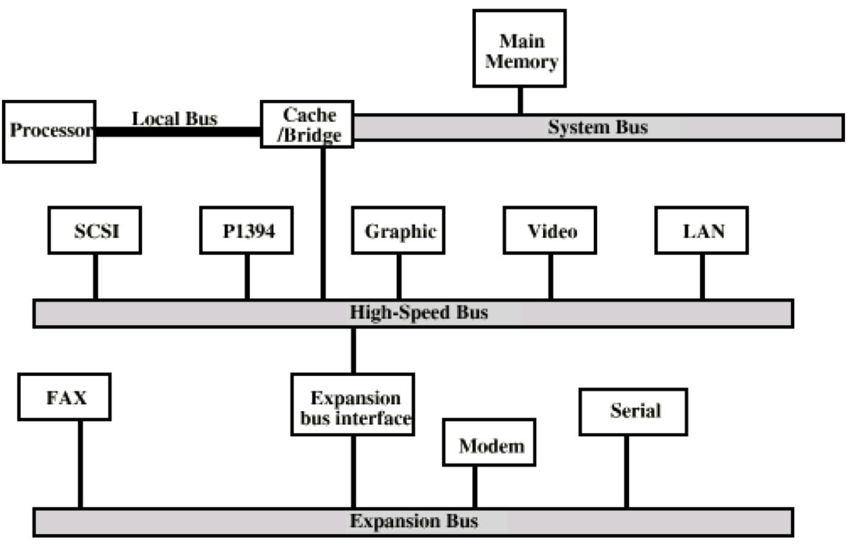
Solution 2: Hierarchical Buses

Slide 14
Data and Address Buses
The data and address buses are what actually handle the data flowing to/from RAM, the CPU, and devices.
The address bus carries which address in “RAM” it is heading to/from (remember with memory mapped systems, not all addresses lead to RAM).
The data bus carries the actual data that is moving.
On a 32-bit system, these buses are usually 32 bits wide, etc., but many exceptions exist.
Some have narrower address buses if they think you won’t use all that space for RAM.
Together, the control, address, and data buses make up the high speed “system bus”.

Slide 15
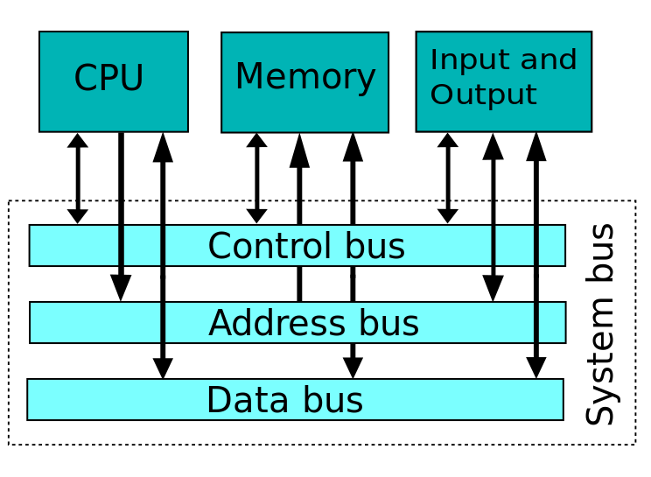
One bus to control them all, and in the darkness bind them...

Slide 16
Memory Maps and Direct Memory Access (DMA)
Typically, every device on a bus will be assigned a different region of memory that maps to where you can read or write to, and the device will pick it up.
So in a bare metal project, you might write to 0xFF00FF00 and that will turn on the camera or something, and 0xFFEEDD00 might be the Ethernet.
So that the CPU doesn’t have to sit there and do every copy between Ethernet and RAM, or whatever, you can set up a “DMA” for most transfers, which is a controller that will block copy data from a device to RAM.
This drastically speeds up systems. The CPU just needs to tell the DMA controller to do a copy, and it’ll get done.

Slide 17
Tri-state Logic
Boolean logic is the notion that everything is either true or false.
Fuzzy logic is the notion you can have truth values in between true and false.
Tri-state logic is the concept that you can have a wire carrying true, false, or “no connection” (by breaking the circuit open), AKA “Z” AKA “Float” AKA “High Impedance” mode.
This is how buses operate effectively – if it’s not your turn to transmit, the control bus will disconnect you from the data and address busses.

Slide 18
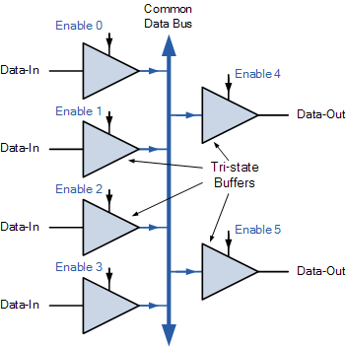

Tri-state(tm) brand logic – Keeping machines safe since 1971

Slide 19
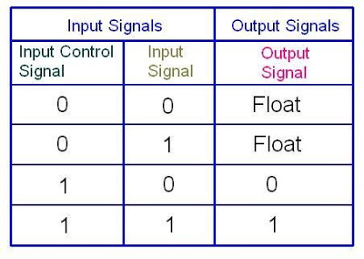
Tri-state Worksheet
This will be your final worksheet for the year.
It will be worth half as much as your ultimate homework, described next.

Slide 20
Ultimate Homework - Code Tennis
Divide class into two sides.
Team A will make a program (in C/C++) that will create an array, populate it with data (image data or programmatic data) and then pass it to three functions written in assembly by Team B, and time it.
Team B will write three functions in assembly that will process the arrays. You can process them however you want. However, you must conform to the following API so that your code will successfully interoperate.
You will not know in advance whose library you will be paired up with. The possibilities are endless!*
*Not actually endless

Slide 21
Ultimate Homework - Code Tennis
Here is the API that both teams must follow:
int function_one(int *arr, int n, int stride);
The return value can be whatever you want
Arr is an integer array of size n.
Stride of 1 equals normal behavior.
Stride means to move +stride ints ahead after every operation
You will always do N operations, though, no matter what.
So yes, this means with a high stride you’ll wrap around a lot.
int function_two(int *arr, int n, int m, int stride);
Same as before, but for a n by m array.
float function_three(float *arr, int n, int stride);
Same as for function_one, but with floats.

Slide 22
Ultimate Homework - Code Tennis
When a member of a team finishes his code, he will turn it into an archive as shown in the previous lecture:
ar rcs archivename.a foo.o (or whatever your .o is)
Name the archive with your teamname-name.a
i.e. “teama-kerney.a”
ONLY TEAM A PEOPLE WILL HAVE A MAIN()
TEAM B PEOPLE WILL CREATE AN ARCHIVE WITH NO MAIN
I will assign you a library file from the other team, and you will link it against your own to create an a.out:
gcc teama-kerney.a teamb-lopez.a

Slide 23
Ultimate Homework - Code Tennis
Then run it and see what happens!
Most importantly, the Team A people must process command line parameters to accept an array size and stride size, and must output nothing other than how long it took each function to run.
Record and graph your timing data with 10 different array sizes and 5 different stride lengths.
Write a short 1-page report on what you find.
For fun, try to figure out what the other person was doing with their code. Was the Team A person making a series of red rectangles? Was the Team B person implementing a blur filter? Write it down!
Reports due on the final, archives are due halfway till then.

